Slide 1
Backward Design
Course (Re)Design Workshop Series
Dr. Bouchra Bakach

Slide 2
Workshop Objectives
Distinguish Between the Traditional and Backward Design
1
Explain the Benefits of the Backward Design
2
Identify the 3 Steps of the Backward Design Process
3
Use the Backward Design Template
4

Slide 3
Think about this Scenario!
You are asked to teach a new course…
What steps might you take to design the course?
Would you select the textbook first?
Would you choose a teaching approach that has served you well in the past, i.e., using lectures, flipped method,…?
Would you create first the syllabus then start designing and developing the teaching material?
…

Slide 4
Typically, We….
Does that sound familiar???
Look at the program goals, course description…
Look for any past syllabi if available…
Select a textbook, look for reading material…
Prepare lectures, PPTs, handouts…
Write HW assignments and exams questions

Slide 5
The “Twin Sins” of Traditional Design
Activity-Focused Instruction
Coverage-Focused Instruction

Slide 6
Backward Design
1. Identify Desired Results
What do you want students to learn?
2. Determine Acceptable Evidence
How will you know if they’ve learned it?
2. Plan Learning Experiences and Instruction
What activities will help them learn?

Slide 7
Traditional vs. Backward Course Design
Goals
Activities
Assessments
Goals
Assessments
Activities

Slide 8
Primary Goals of Backward Design
Shift Thinking From Teacher-Centered to Student-Centered Design.
Intentional Course Design and Lesson Planning
Alignment Between Learning Objectives, Assessment and Learning activities/Material.
Focus on Students' Understanding and Their Ability to Use the Stuff, Not Just Learn the Stuff.
Easy Course File Submission at the End of Semester.

Slide 9
Stage 1:
Identify Desired Results
Handout 1

Slide 10
Outcomes Priorities
important knowledge (facts, concepts and principles) and skills (processes, strategies and methods)
Student learning is incomplete if the unit or course completed without the mastery of these essentials
Things we want student to “hear, read, view, encounter, research or otherwise encounter”
Broad- Brush knowledge
Nice to know
Example:
Important to Know and do
“understandings that will anchor the unit or course”
the important understandings, that we want students to ‘get inside of’ and retain after they’ve forgotten many of the details”
Big Ideas
And
Enduring
Understanding
Example:
Example:

Slide 11
Four Categories of Desired Results
01
Established Goals
What relevant goals (e.g., established program and course student learning outcomes, accreditation standards, etc.) will this unit address?
02
Enduring Understanding
What are the knowledge, ideas and skills you would like students to remember or do, well beyond your course?
03
Essential Questions
What are the open-ended provocative questions I should design to guide student inquiry and focus on uncovering big ideas?
04
Knowledge and Skills
What are the discrete objectives students are to know and be able to do.
Notes:
Backward Design is a great tool for building online courses (face to face courses as well!). Knowing the final outcomes you want students to achieve helps to guide you through your entire course development.
In the online classroom organization and explicitness is a must; it can help you achieve those goals by making sure each activity is tied to the desired final outcome.
Backward Design also provides transparency for students - in your final product (the course) they get to see what they should be learning, how the information they are reading and watching is relevant to their learning, and how the activities and assessments are helping them to achieve the goals of the course, connecting their learning to the course content.

Slide 12
Course Title: Introduction to International Business
Learning Module: Module 2
Teaching modality: face-to-face
Semester/Year: Fall 2023
Stage 1 – Desired Results
Established Goal(s): Program outcome 2: Conduct an environmental scan to evaluate the impact of world issues on an organization’s international business opportunities. Standard 9.3.12.BM‐MGT.3- Apply economic concepts fundamental to global business operations. Standard 9.3.12.BM‐MGT.4- Employ and manage techniques, strategies and systems to enhance business relationships.

Slide 13
Stage 2:
Determine Acceptable Evidence

Slide 14
Stage 2 Guiding Questions
What is sufficient and telling evidence of understanding?
What performance tasks should anchor the focus of the unit?
What criteria will be used to assess the work?
Will the assessment reveal and distinguish those who really understand and those who only seem to understand?

Slide 15
Steps to Determine Assessments
1. Select a learning outcome.
2. Using a Taxonomy, identify the level of thinking or cognition required by the learning outcome. (Handout: Blooms Taxonomy)
3. Identify the type of assessments you could use.

Slide 16
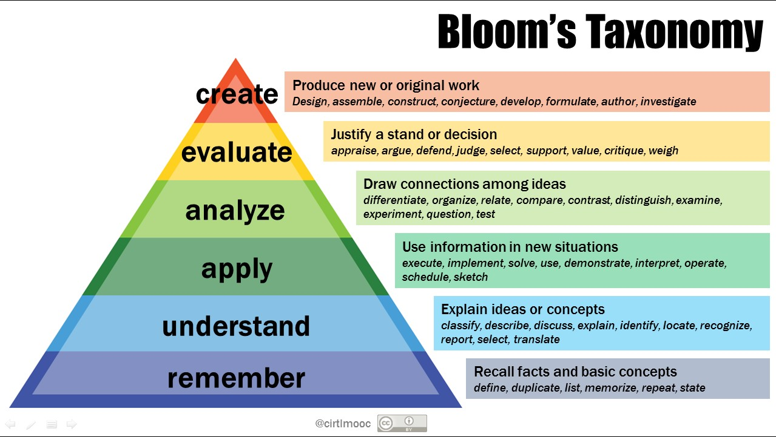
Example
Students will be able to interpret how international business and internationalization has influenced our global economy
Cognitive Level of Learning Outcome | Assessment Types
Application | Discussion board post E-portfolio Lab reports One-minute paper Presentation Case study Problem-solving tasks Short answers Tests ….

Slide 17
Stage 3:
Plan Learning Experiences and Instruction

Slide 18
Stage 3 Guiding Questions
What enabling knowledge (facts, concepts, principles) and skills (processes, procedures, strategies) will students need in order to perform effectively and achieve desired results?
How will progress be monitored?
What activities, experiences, and lessons will lead to achievement of the desired results and success at the assessments?
How will the unit be sequenced and differentiated to optimize achievement for all learners?
How will the learning plan help students achieve transfer, and meaning and acquisition, with increasing independence?
Are the learning events in Stage 3 aligned with Stage 1 goals and Stage 2 assessments?

Slide 19
Stage 3 Example

Slide 20
Additional Subtasks
Identify additional course components that needs to be added to the course in order to facilitate the learning process. For example: a syllabus, course Schedule, Supplemental materials, example of previous students’ projects, etc.
Design course structure by dividing content materials and course components into modules.
Design instructional strategies (e.g., lecture notes or lecture notes + video demonstration)
Find online resources and materials that could be available for your students in your discipline. These materials may be journal articles, online books, freely available multimedia, tutorials, etc.

Slide 21
Questions & Discussion

Slide 22
Contact Info
@
bbakach@alfaisal.edu
+966 11 215 7774
BG.085C

Slide 23
Designing Backwards
WHY?
To eliminate instruction that is activity oriented or coverage oriented
WHAT?
Identify desired results
Determine acceptable evidence
Plan learning experiences/instruction

